Slide 1


Grammar Correction by Fine Tuning BERT
Presented by
Name: Vijaiey Anand S
Intern ID: MST03-0024
Guided by: Ms. Urooj Khan

Slide 2
Introduction
English – connecting language.
Importance of grammar in English – convey the meaning.

Slide 3
Objective
The main objective is to correct grammar mistakes by fine tuning BERT model.
The objective of the grammar correction app is to create a simple web application using streamlit that utilizes a fine-tuned BERT model to correct grammatical errors in input sentences.

Slide 4
Dataset
The dataset contains Serial Number, Error Type, Ungrammatical Statement and Standard English sentence.
The shape of the dataset is (2018, 4).
Only Ungrammatical Statement and Standard English are used here.
For testing 0.8*length(dataset).
For training 0.2* length(dataset).

Slide 5
Tech Stack
Python
Pandas
Torch
Transformers
Matplotlib

Slide 6
Python: High-level programming language known for its simplicity and versatility.
Pandas: Python library for data manipulation and analysis.
Torch: Open-source machine learning framework, primarily used for deep learning.
Transformers: State-of-the-art models for natural language processing (NLP).
Matplotlib: Python plotting library for creating visualizations.

Slide 7
BERT Model
The model used was BERT – pre trained model from hugging face.
BERT (Bidirectional Encoder Representations from Transformers).
BERT-Base, Uncased: 12-layer, 768-hidden, 12-heads, 110M parameters.
It utilizes a transformer-based architecture to encode contextual information from input text, making it suitable for a wide range of natural language processing tasks, including grammatical error correction.

Slide 8
Work flow
Import libraries and load pre-trained model
Text pre-processing
Evaluation
Model fine tuning
Prediction
App creation
Load dataset
Split data for Training and Validation

Slide 9
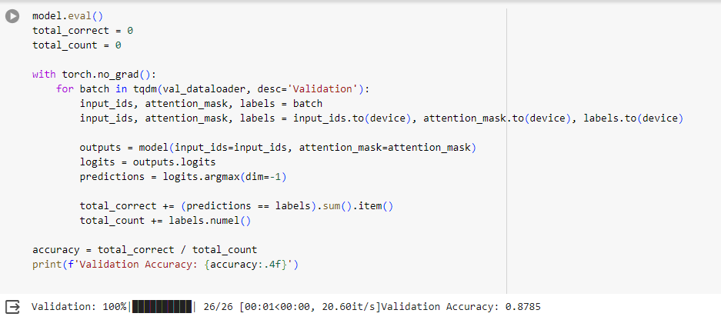
Accuracy
The accuracy of the model is 87.85%.

Slide 10
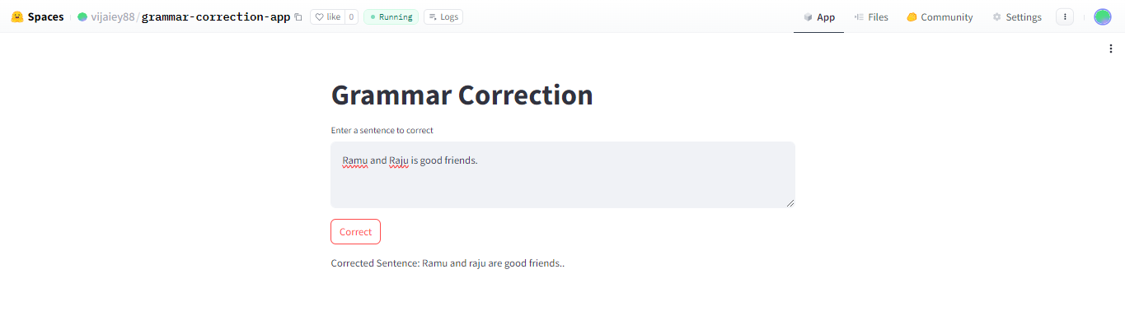
Deployment
The application was created by streamlit and deployed in hugging face public community.

Slide 11
Conclusion
The grammar correction app was able to correct the grammar mistakes for most of the sentence but can improved by training with larger dataset.
App link: Grammar Correction App

Slide 12
Thank you!

